Slide 1
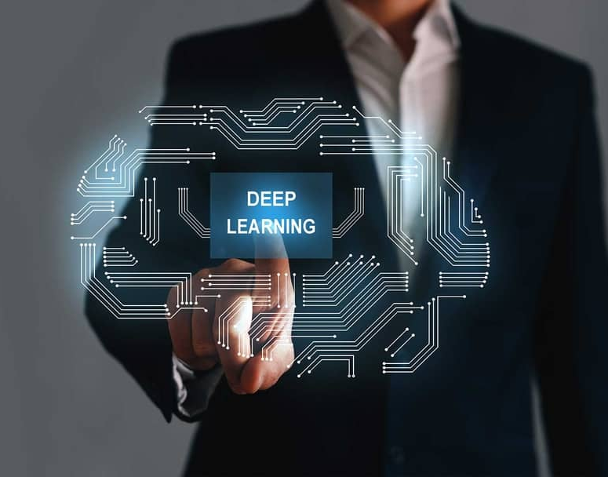
Network Compression and Its Application
Yuzhang Shang
20/Sep/2023

Slide 2
Lipschitz Continuity Guided Knowledge Distillation
Yuzhang Shang, Bin Duan, Ziliang Zong, Liqiang Nie, Yan Yan. IEEE International Conference on Computer Vision (ICCV), 2021
Notes:
Next, I would like to introduce my completed work, the first one is about knowledge distillation.
It is named Lipschitz Continuity Guided Knowledge Distillation.

Slide 3
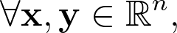
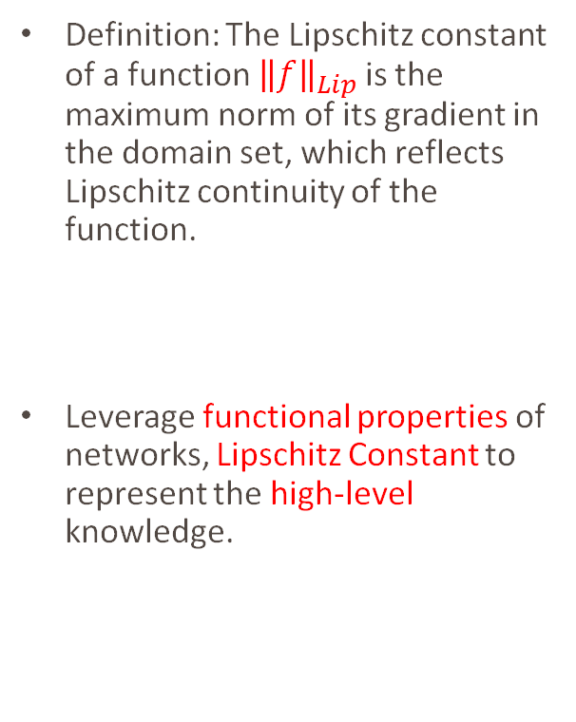
Motivations
Definition: The Lipschitz constant of a function ${\left\|f\right\|}_{Lip}$is the maximum norm of its gradient in the domain set, which reflects Lipschitz continuity of the function.
Leverage functional properties of networks, Lipschitz Constant to represent the high-level knowledge.

Slide 4
Background of Lipschitz Constant
Researchers used Spectral Normalization, to smooth the discriminator function in GAN for synthesizing realistic image. [Miyato et al. ICLR 2018]
In adversarial attack machine learning, authors propose constraining local Lipschitz constants of neural networks to avoid adversarial attacks. [Weng et al. ICLR 2018]
Many studies underline the significance of Lipschitz constant in neural networks' expressiveness and robustness. [Neyshabur et al. NeurIPS 2017]

Slide 5
LONDON: Lipschitz Continuity Guided Knowledge Distillation
Module-wisely, instead of layer-wisely.
Design a series of Transmitting Matrix to avoid NP-hard computation.
Loss function:

Slide 6
Transmitting Matrix
A novel method to approximate the Lipschitz constants of neural networks.
Take fully advantage of the feature maps.
Prove the effectiveness of LONDON.

Slide 7
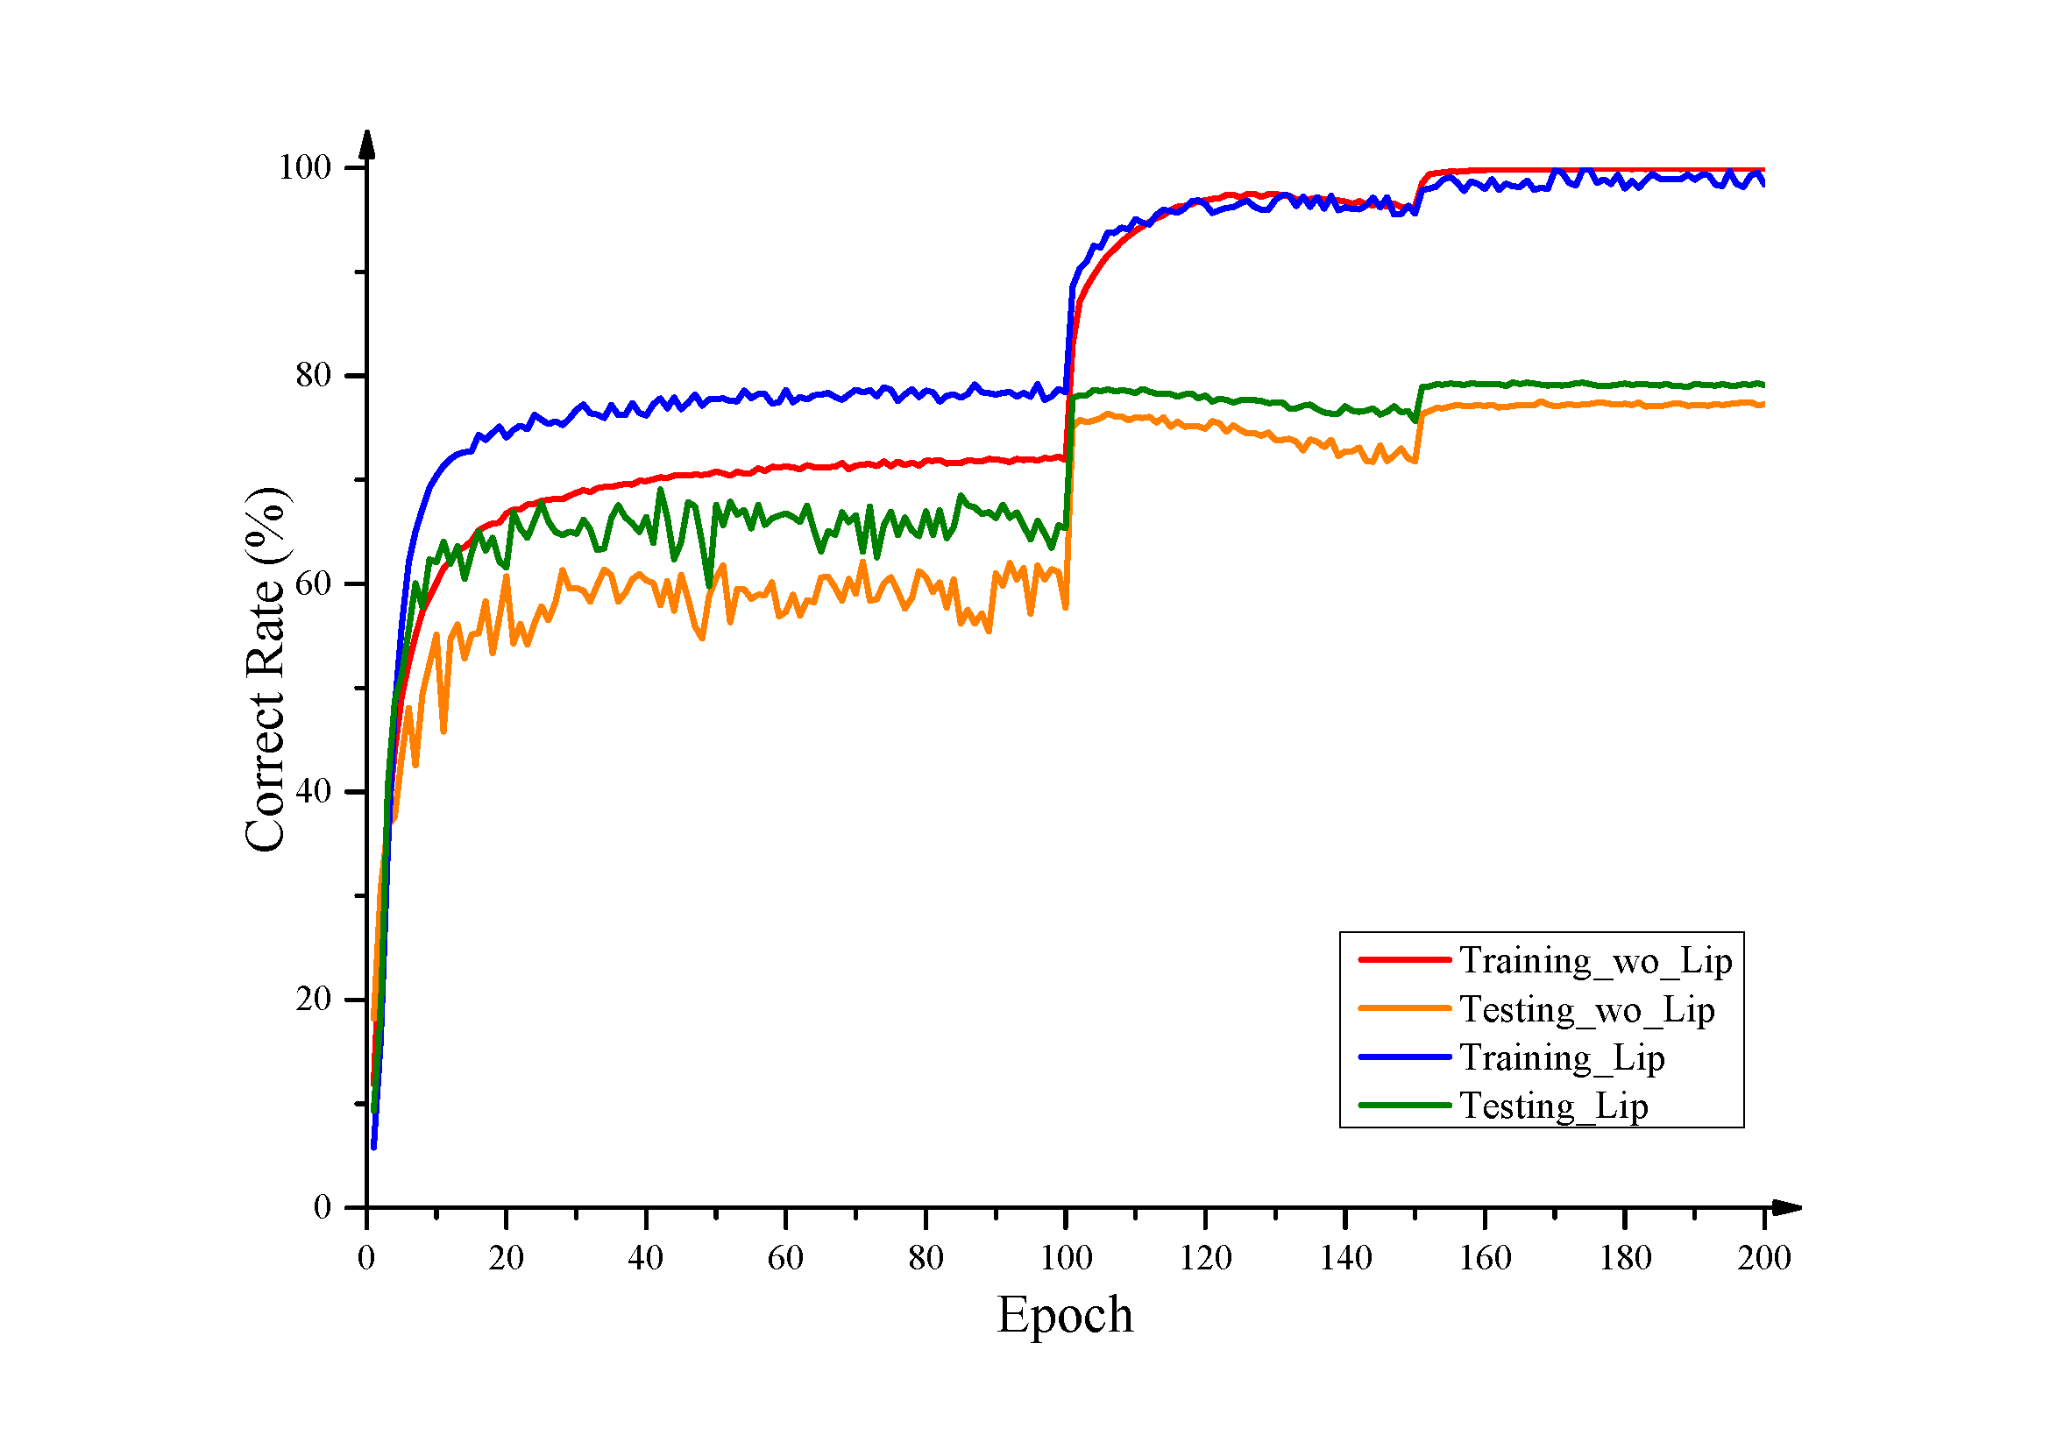
Mitigate Overfitting
The Lipschitz distillation can be seen as a regularization term.

Slide 8
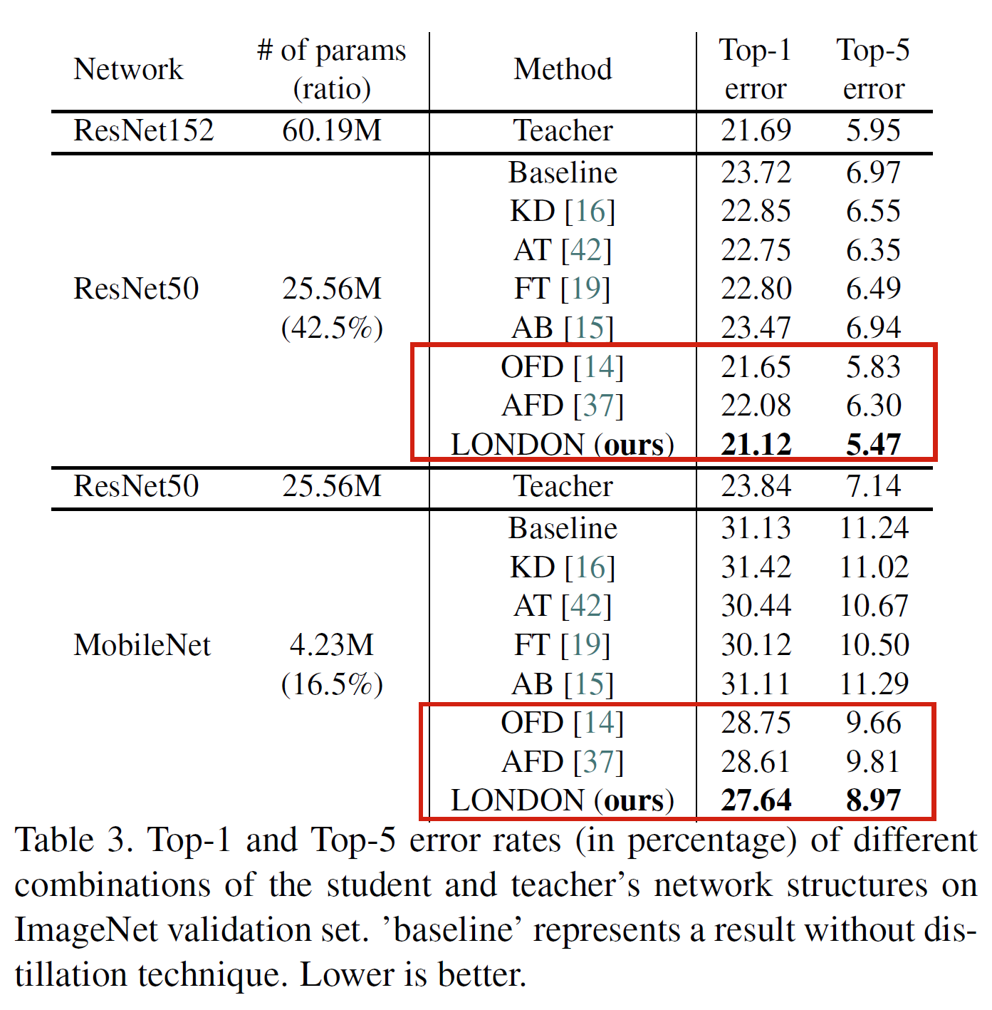
Results on ImageNet Classification
Improve 1% accuracy.
Plug-and-play in different architectures.

Slide 9
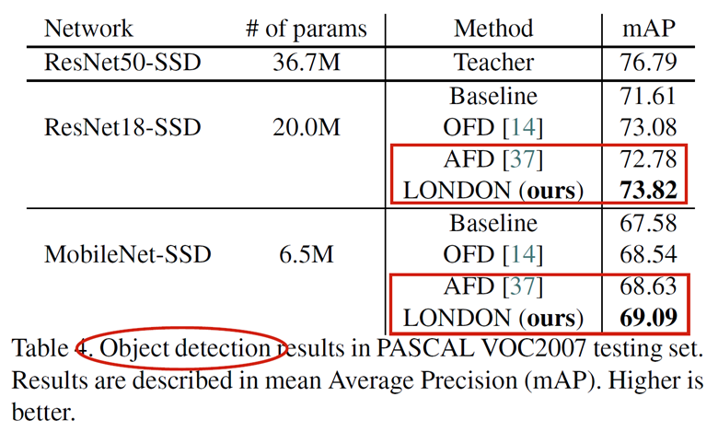
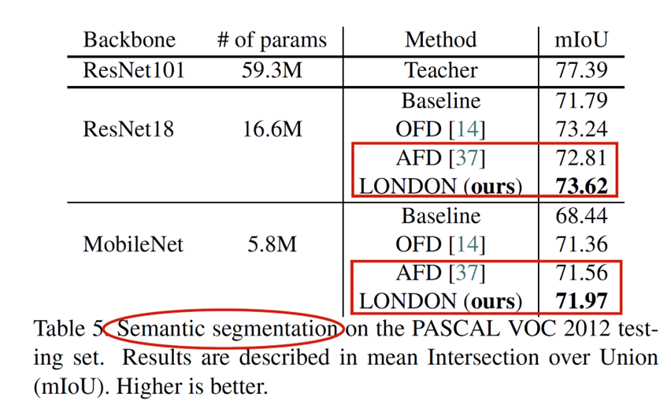
Results on Object Detection and Segmentation

Slide 10
Network Binarization via Contrastive Learning
Yuzhang Shang, Dan Xu, Ziliang Zong, Liqiang Nie, Yan Yan; European Conference on Computer Vision (ECCV), 2022

Slide 11
Problems of Existing Binarization Methods
As the quantization error caused by weights binarization has been reduced in earlier works.
The activations binarization becomes the major obstacle for further improvement of the accuracy.
Sharing information between float-point and binary activations have never been considered.

Slide 12
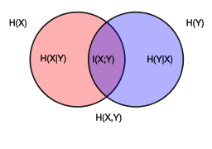
Motivations
To mitigate the information degradation caused by the binarization operation from FP to binary activations
We establish a contrastive learning framework while training BNNs through the lens of Mutual Information (MI) maximization.
Mutual Information (MI, $I(X;Y)$) between two variables

Slide 13
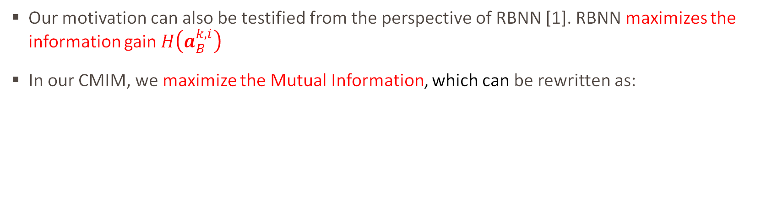
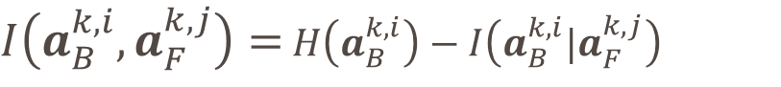
Mutual Information and Contrastive Learning
Our motivation can also be testified from the perspective of RBNN [1]. RBNN maximizes the information gain $H\left(a_{B}^{k,i}\right)$
In our CMIM, we maximize the Mutual Information, which can be rewritten as:
$I\left(a_{B}^{k,i},a_{F}^{k,j}\right)=$ $H\left(a_{B}^{k,i}\right)−I\left(a_{B}^{k,i}|a_{F}^{k,j}\right)$
[1] Rotated Binary Neural Network in NeurIPS 2020 M. Lin et al.
Notes:
Explain the equation

Slide 14
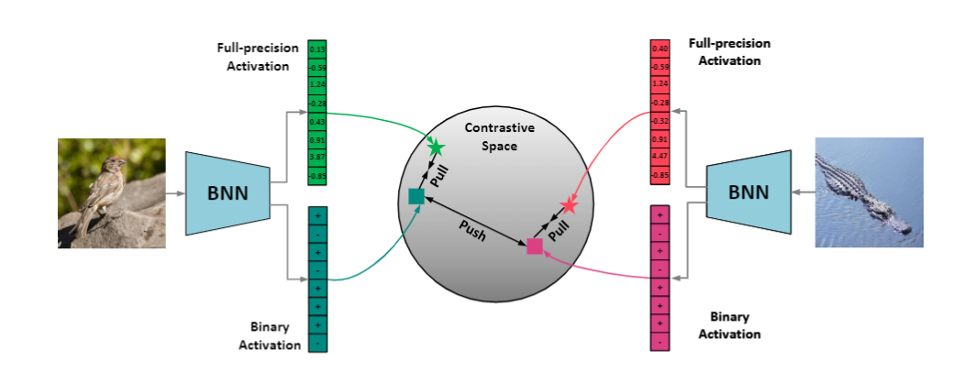
CMIM: Network Binarization via Contrastive Learning
Feeding two images into a BNN, and obtaining the three pairs of binary and full-precision activations.
Our goal is to embed the activations into a contrastive space, then learn from the pair correlation with the contrastive learning task.

Slide 15
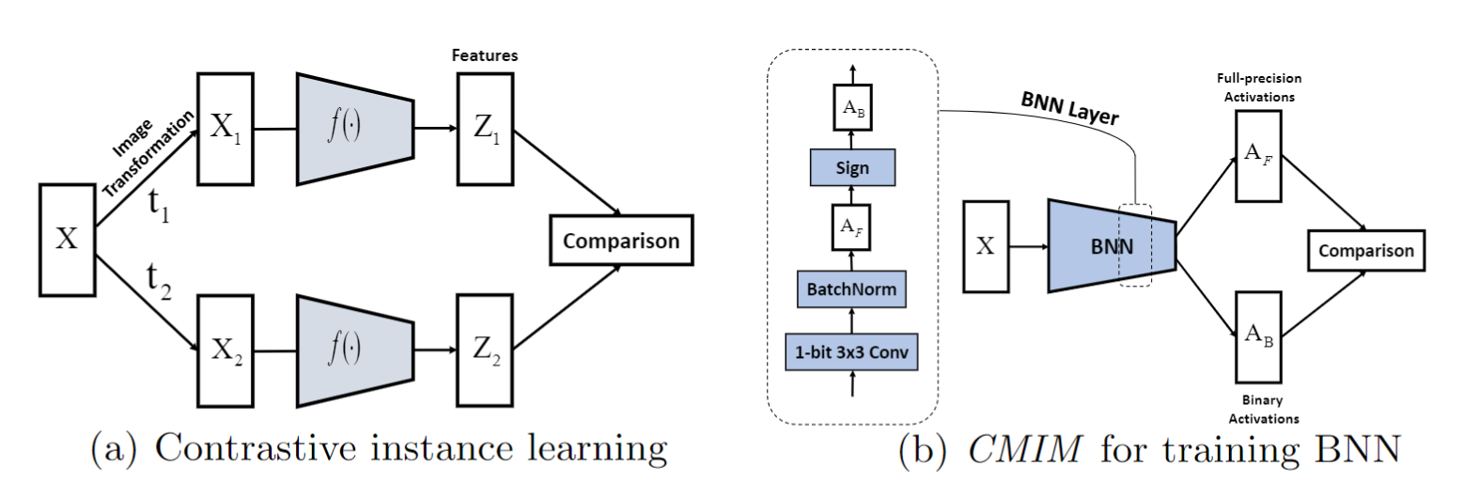
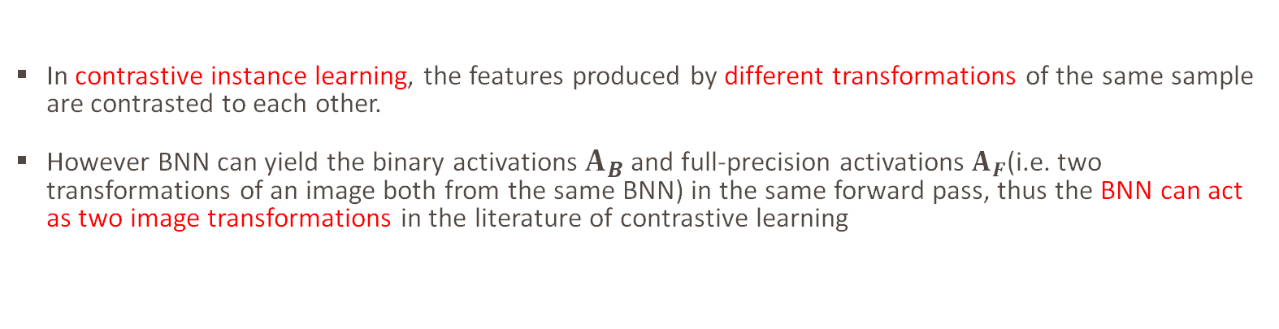
Intuitive Explanation
In contrastive instance learning, the features produced by different transformations of the same sample are contrasted to each other.
However BNN can yield the binary activations $A_{B}$ and full-precision activations $A_{F}$(i.e. two transformations of an image both from the same BNN) in the same forward pass, thus the BNN can act as two image transformations in the literature of contrastive learning

Slide 16
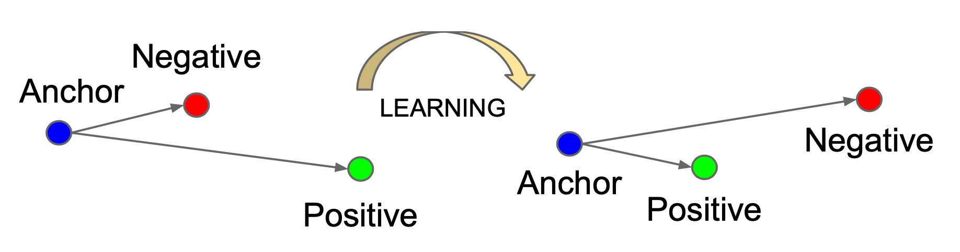
Contrastive Loss for Binarization
We define the contrastive loss function NCE between the k-th layer’s activations:

Slide 17
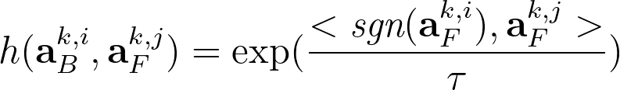
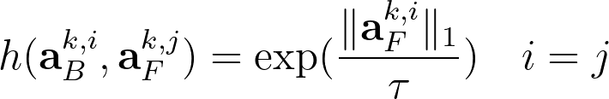
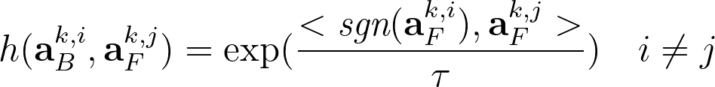
Critic Function for Binary Activations
Working mechanism of CMIM from a perspective of activation flip.
Turn the + activation into -, binary activation in the critic can pull the activations in positive pair close and push the ones in the negative pair away via inner product.
Citric Function:
Citric Function:

Slide 18
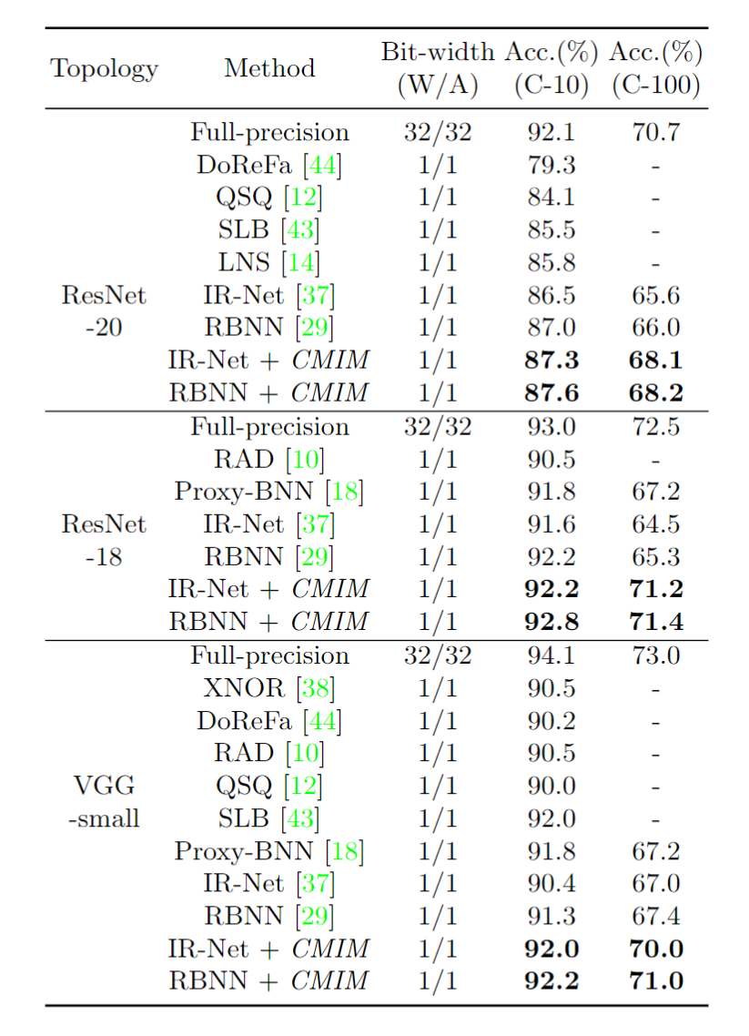
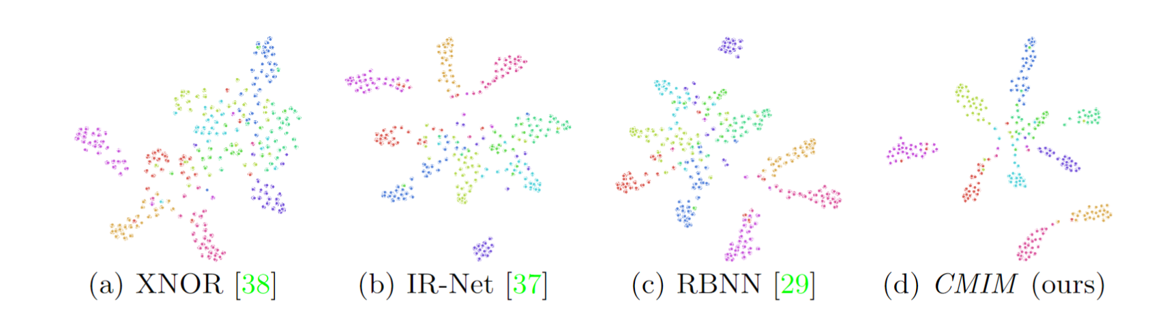
Experimental Results
Our method can endow BNN more representative ability.
Improve BNN SoTA by 3%.
Plug-and-play in different architectures.

Slide 19
Post-training Quantization on Diffusion Models
Yuzhang Shang, Zhihang Yuan, Bin Xie, Bingzhe Wu, Yan Yan;
IEEE Conference on Computer Vision and Pattern Recognition (CVPR), 2023

Slide 20
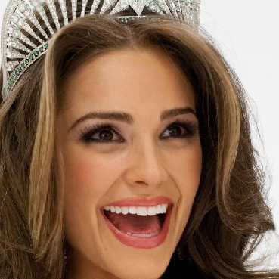
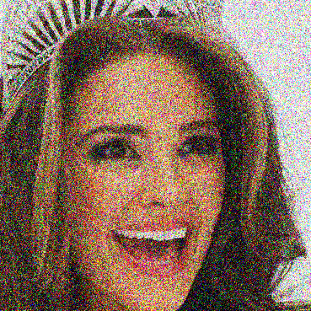
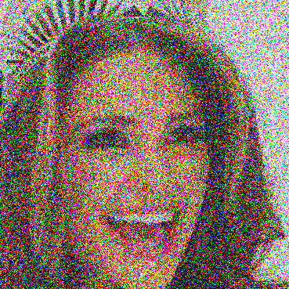

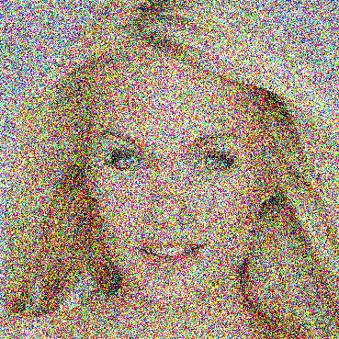
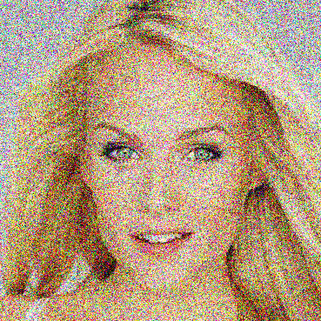
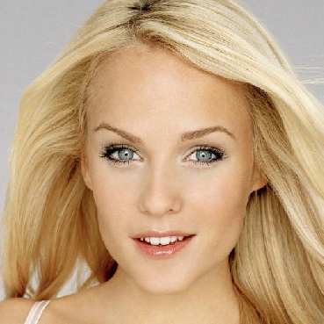
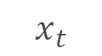
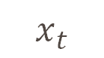
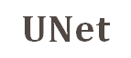
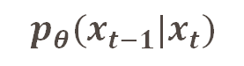

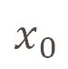
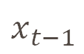
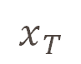

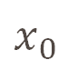
Background: Diffusion Models
Diffusion
Process
$${q(x}_{t}|x_{t−1})$$
$$x_{0}$$
$$x_{t−1}$$
$$x_{t}$$
$$x_{T}$$
$$UNet$$
Denoising
Process
En-coder
De-coder
$$x_{T}$$
$$x_{t}$$
$${p_{θ}(x}_{t−1}|x_{t})$$
$$x_{t−1}$$
$$x_{0}$$
The goal of diffusion models is to learn the latent structure of a dataset by modeling the way in which data points diffuse through the latent space.
A neural network is trained to denoise images blurred with Gaussian noise by learning to reverse the diffusion process.

Slide 21
Post Training Quantization (PTQ)
Pretrained Model
Training Data
Pretrained Model
Calibration Data
Quantization
Calibration
Retraining / Finetuning
Quantization
Quantized Model
Quantized Model
Quantization-Aware Training (QAT)
Post-Training Quantization (PTQ)
Training Data FREE!
In QAT, a pre-trained model is quantized and then finetuned using training data to adjust parameters and recover accuracy degradation.
In PTQ, a pre-trained model is calibrated using calibration data (e.g., a small subset of training data) to compute the clipping ranges and the scaling factors.
A survey of quantization methods for efficient neural network inference 2021 Amir et. al.
Notes:
What is Post Training Quantization (PTQ)? Comparison between Quantization-Aware Training and Post-Training Quantization. In QAT, a pre-trained model is quantized and then finetuned using training data to adjust parameters and recover accuracy degradation. In PTQ, a pre-trained model is calibrated using calibration data (e.g., a small subset of training data) to compute the clipping ranges and the scaling factors. Then, the model is quantized based on the calibration result.

Slide 22
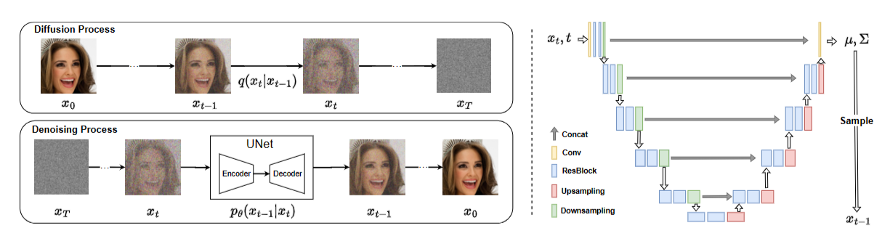
Motivations
The cost of generating a sample is unacceptable.
Two orthogonal factors slow down the denoising process:
i) lengthy iterations for sampling images from noise,
ii) a cumbersome network for estimating noise in each iteration.

Slide 23
Why we need Post-Training Quantization?
Why we need Quantization? (Example: Int8 network is 10x faster than float32 network.)
Reduce model size so that it can be deployed on resource-constrained devices.
Reading and writing data from global memory are expensive, often requiring hundreds of cycles.
Why we need Post-Training manner?
Quantization via model re-training (Quantization-Aware Training method) is computational expensive.
Float32 models are always accessible, but training data are not accessible.

Slide 24
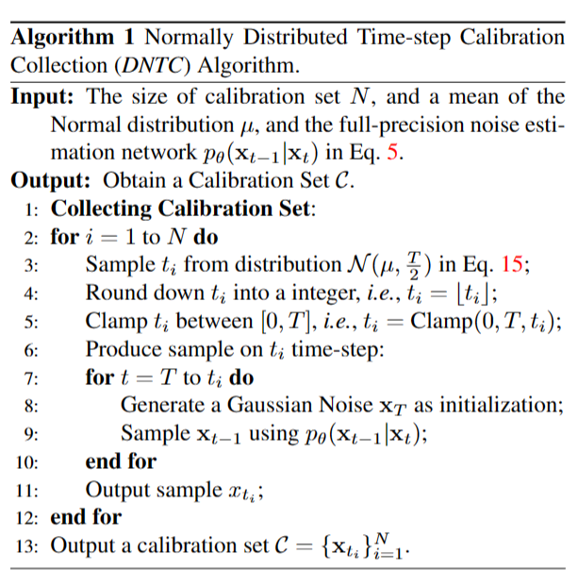
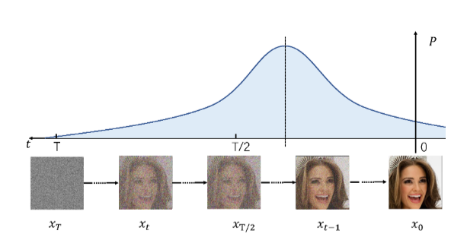
Normally Distributed Time-step Calibration
We desire the calibration samples:
Generated by the denoising process with the full-precision diffusion model.
Relatively close to clean images and far away from noise.
Covered by various time-steps.

Slide 25


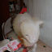
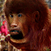
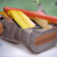
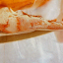

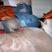
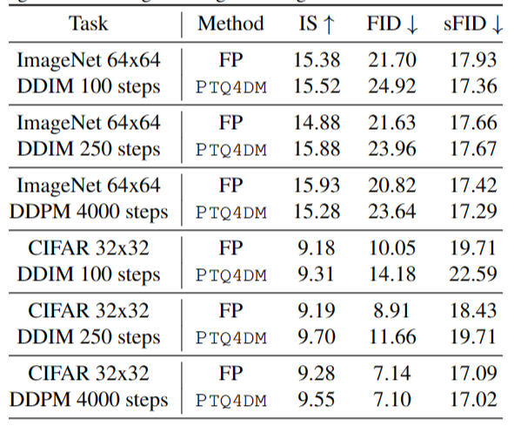

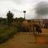
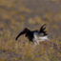
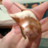
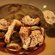


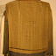
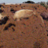
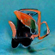

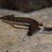




























Experimental Results
Speedup diffusion models 4 times while maintaining comparable performance.

Slide 26
In-process Works

Slide 27
Efficient LLM
RPTQ: Reorder-based Post-training Quantization for Large Language Models
Activation Quantization
Reorder-based approach
W3A3KV OPT-175b
Training-aware Quantization
Training (data) efficient
Extremely-low bit
Leveraging the outliers
QLoRA + LLM Explainability
Compressing focusing on unimportant (in terms of explainability) weights

Slide 28
Questions for Tim
Does PTQ for LLM still have space? 3 or 2 bit possible?
What do you think of QAT for LLM? Other network work training-aware compression techniques for LLM compression?
Is efficient PEFT a good direction?
Any following works for QLoRA?
Career goal
How to get involved into an impactful work.
Academia or industry?

